Slide 1

Energy Driven
PERSONAL
PRODUCTIVITY
COMPANION
NAME: MARRI HRUTHIKA
ROLL NO: 2520090002
CLUSTER: 1
SECTION: 1
Under the Guidance of
Supervisor name: Surekha
Assistant Profesor of
Department of CSE

Slide 2
OUTLINE
1. Abstract
2. Existing System
3. Proposed System
4. System Architecture
5. Project Modules
6. Objectives
7. Co’s Attainments - FWD
1. Co1
2. Co2 ........ 5. Co5
8. Co’s Attainments - DSA
1. Co1
2. Co2 ........ 5. Co5
9. Screen Shots for FWD & DSA
10. Conclusion
11. Geo-Tagged Photos

Slide 3
ABSTRACT:
In today’s fast-paced and digitally driven world, productivity is commonly managed through rigid schedules, deadlines, and time-based planning systems. However, human performance is not constant throughout the day; it fluctuates based on energy levels, mental focus, emotional state, and fatigue. Traditional task management systems often ignore these natural variations, leading to procrastination, reduced efficiency, and burnout. The Energy Driven Personal Productivity Companion addresses this limitation by introducing an energy-aware approach to productivity management. Instead of focusing solely on “what needs to be done” and “by when,” the system emphasizes “when is the user best suited to perform a particular task,” thereby aligning work intensity with real-time energy conditions.

Slide 4
This web-based application enables users to create and categorize tasks based on priority and deadlines while also performing regular energy and mood check-ins. Using this input, the system intelligently recommends suitable tasks that match the user’s current energy level, ensuring optimal performance without overexertion. The platform further integrates an adaptive focus timer with selectable concentration modes—high, medium, and normal—allowing users to customize work sessions according to their capacity. A productivity scoring mechanism tracks completed tasks, focus sessions, and energy-task alignment, offering insights into performance trends over time. Additionally, the system provides motivational feedback and improvement suggestions to encourage consistency and sustainable productivity. By combining structured task management with human-centric energy awareness, this project promotes smarter work habits, reduces mental fatigue, and supports balanced daily productivity through a practical and user-focused framework.

Slide 5
EXISTING SYSTEM
Most existing productivity applications focus mainly on basic task management features such as to-do lists, reminders, and calendar scheduling.
These systems allow users to add tasks, set deadlines, and receive notifications, but they do not analyze the user's productivity patterns.
Traditional task management tools treat all tasks equally, regardless of the user’s mental or physical energy level.
In reality, human productivity varies significantly throughout the day due to fatigue, focus levels, stress, and motivation.
Users often attempt complex tasks when they are tired or mentally exhausted, which leads to low performance and decreased efficiency.
Existing systems lack intelligent task prioritization based on energy levels.
There is no mechanism to match task difficulty with the user’s current productivity state.
As a result, users may experience reduced productivity, incomplete tasks, and increased stress.
Therefore, there is a need for a system that considers human energy fluctuations when scheduling and recommending tasks.

Slide 6
PROPOSED SYSTEM
FlowAlign is an energy-driven productivity companion designed to help users organize their tasks based on their current energy levels.
The system introduces an intelligent way of managing tasks by aligning task difficulty with the user’s mental and physical energy state.
Users can categorize tasks into High Energy, Medium Energy, and Low Energy tasks depending on the effort required.
The application allows users to select their current energy level at any time during the day.
Based on this selection, FlowAlign recommends tasks that best match the user's productivity level.
High-energy tasks such as complex studying, coding, or problem solving are suggested when the user is highly focused.
Medium-energy tasks like planning, organizing notes, or reviewing work are suggested during moderate productivity levels.
Low-energy tasks such as checking emails, simple updates, or small administrative work are suggested when the user feels tired.
This system ensures that users work smarter instead of harder by doing the right tasks at the right time.
FlowAlign ultimately helps improve time management, focus, productivity, and work-life balance.

Slide 7
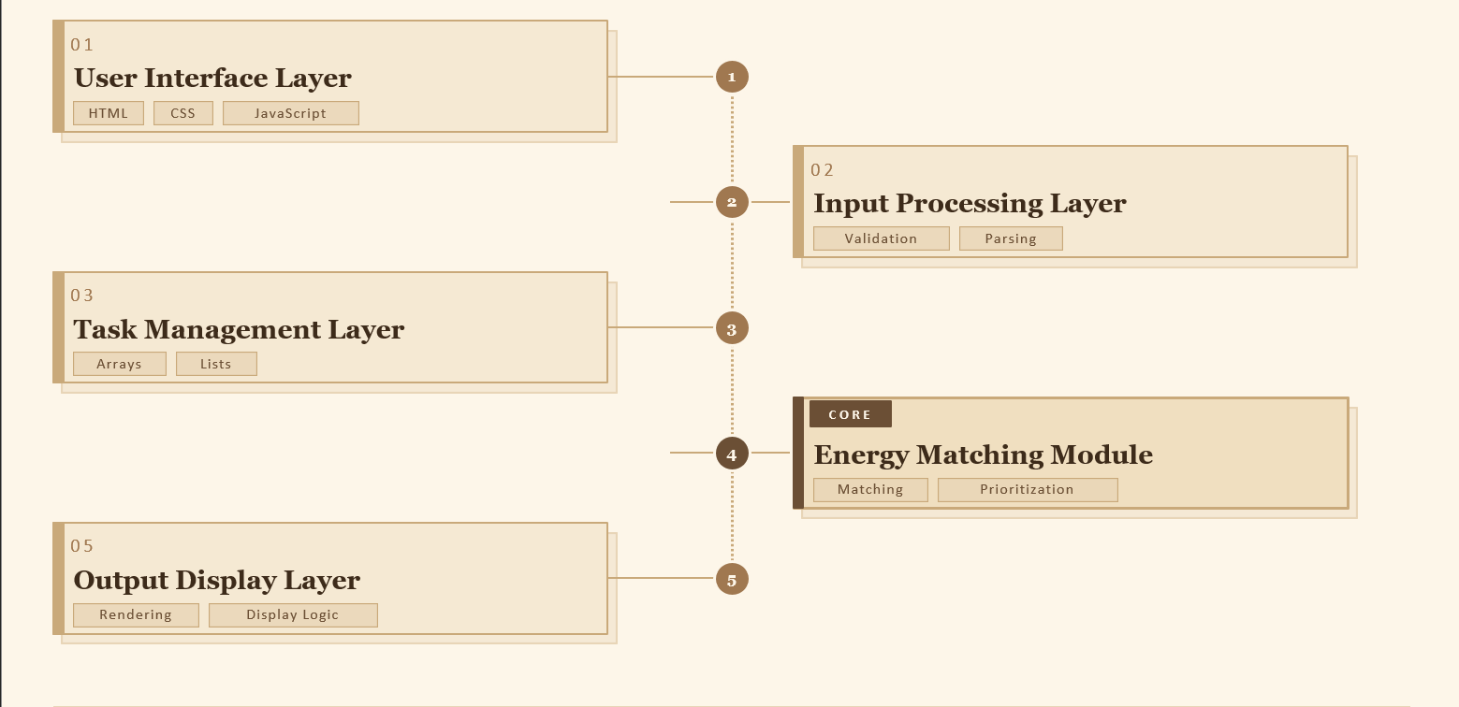
SYSTEM ARCHITECTURE

Slide 8
PROJECT MODULES
User Input Module
Task Storage Module
Energy Classification Module
Allows users to add new tasks to the system.
Users specify the task name, description, and required energy level.
Stores all tasks entered by the user.
Uses data structures to maintain tasks in an organized way.
Enables quick access and modification of tasks.
Categorizes tasks into high, medium, or low energy groups.
Helps the system identify the suitable tasks for different productivity states.
Recommendation Module
Display Module
The main intelligence of FlowAlign.
Matches the user's current energy level with stored tasks.
Provides personalized task recommendations.
Shows recommended tasks and task lists on the interface.
Provides a clear and easy-to-understand productivity dashboard.

Slide 9
OBJECTIVES
The main objectives of developing FlowAlign are:
To design a smart productivity companion system that adapts to user energy levels.
To help users manage tasks more efficiently by matching tasks with their productivity levels.
To improve focus and time management in daily activities.
To reduce mental fatigue by ensuring difficult tasks are performed during high energy periods.
To create an intuitive system that helps users maintain better work balance and productivity habits.
To implement Frontend Web Development technologies such as HTML, CSS, and JavaScript.
To apply Data Structures concepts to manage and organize tasks efficiently.
To demonstrate how technology can support smart personal productivity management.

Slide 10
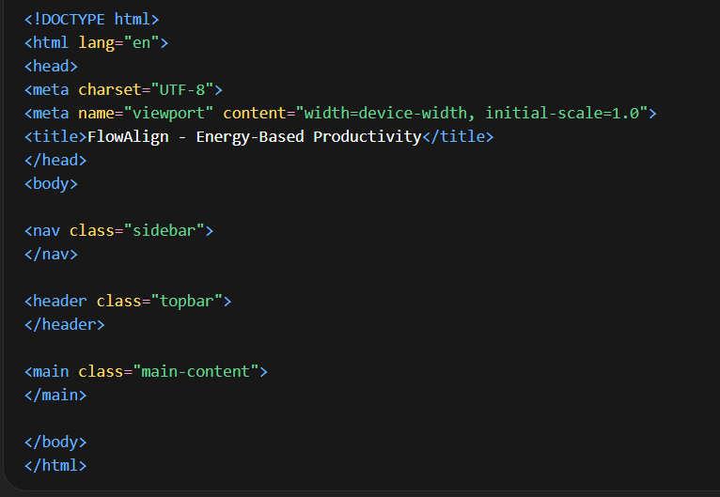
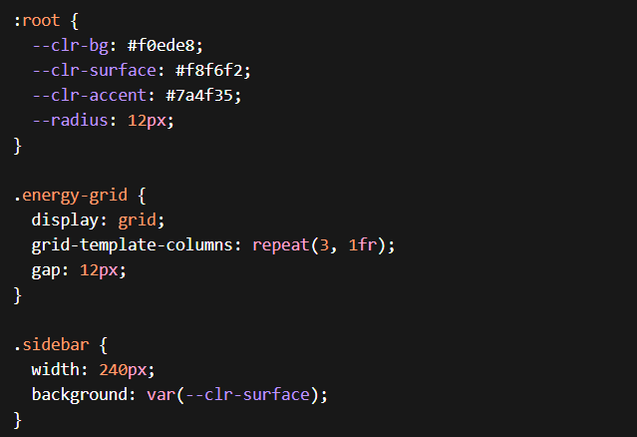
CO’S ATTAINMENTS(FWD)
CO1 – HTML Structure
CO2 – CSS Styling
Implemented semantic HTML structure
Used proper document layout
Used CSS variables and responsive layouts
Implemented animations and theme styling

Slide 11
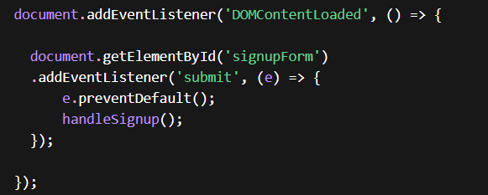
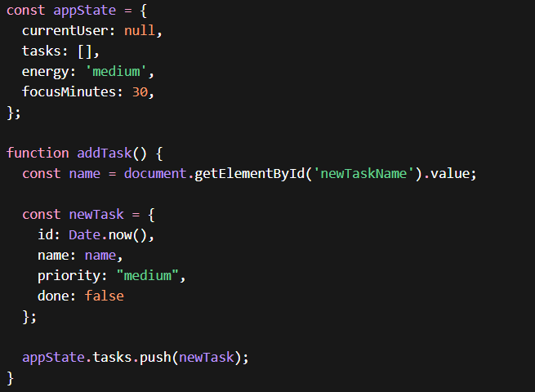
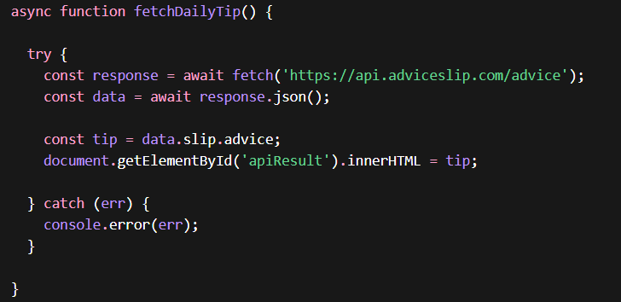
CO4 – DOM Manipulation and Event Handling
CO3 – JavaScript Programming Logic
Implemented DOM manipulation for dynamic UI updates.
Used event listeners to handle user interactions.
Implemented JavaScript functions for task management.
Used arrays and objects to store tasks.
Applied logical operations and functions for application behavior.
CO5 – API Integration and Exception Handling
Implemented API integration using Fetch API.
Added exception handling using try–catch.

Slide 12
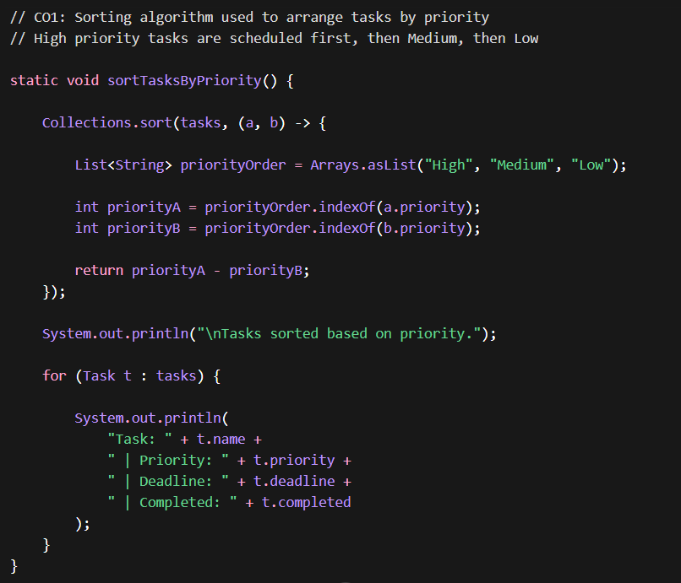
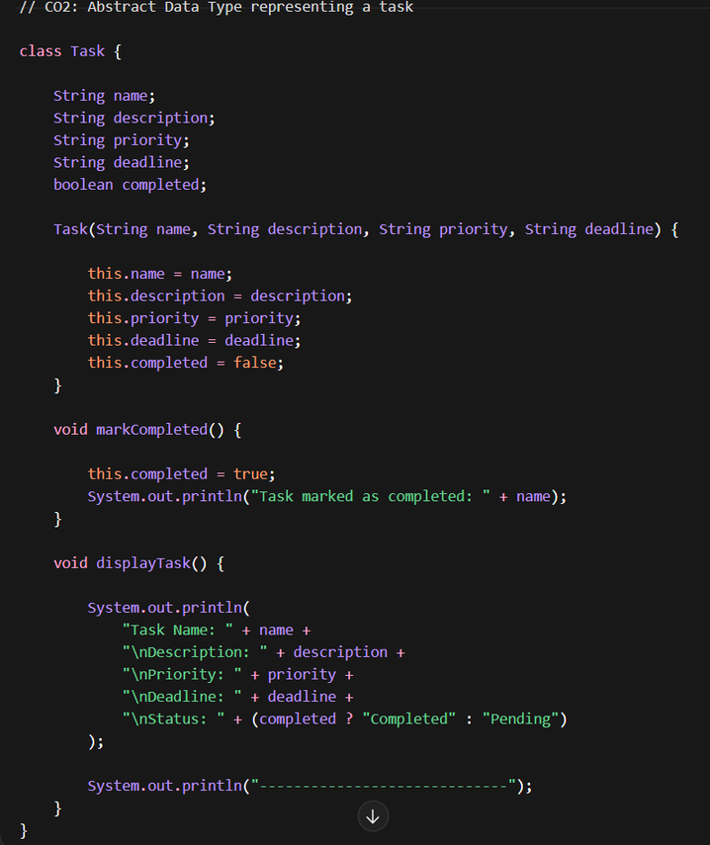
CO’S ATTAINMENTS(DSA)
CO1 – Algorithm Design
CO2 – Abstract Data Type

Slide 13
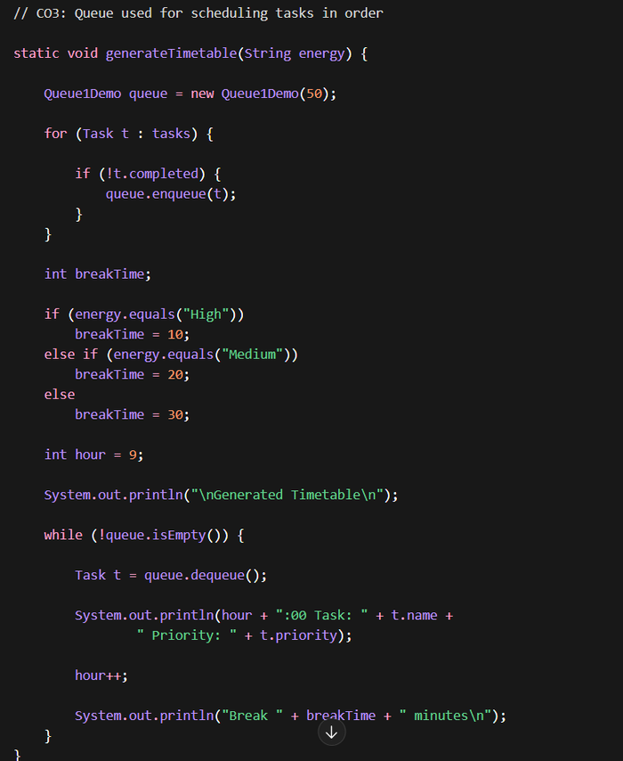
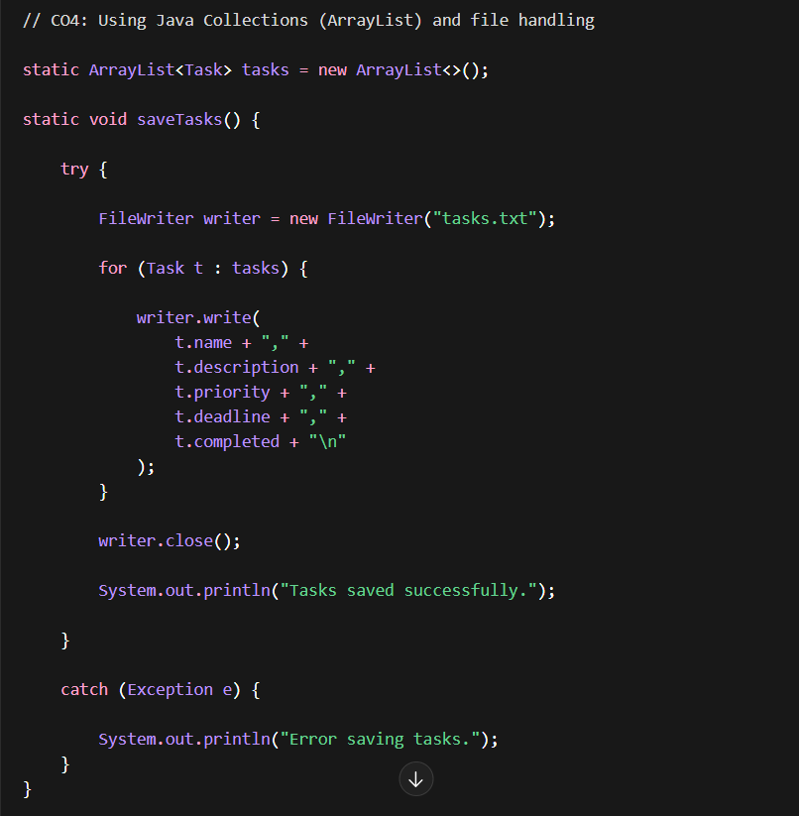
CO3 – Stack & Queue
CO4 – Java Collections

Slide 14
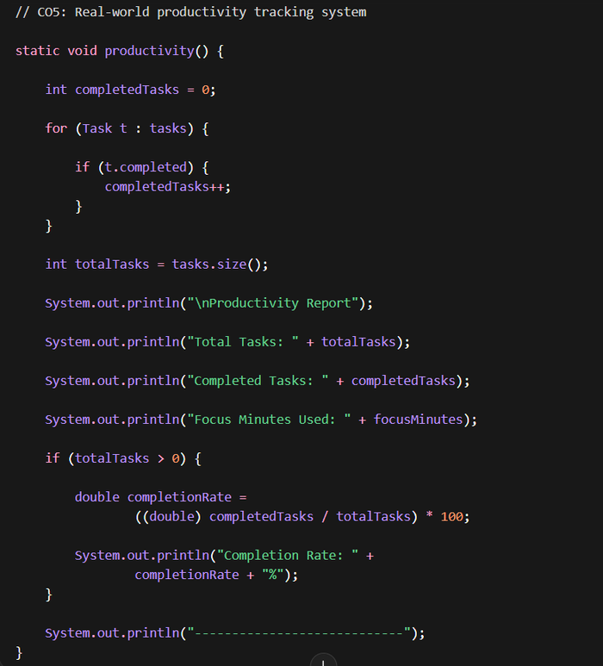
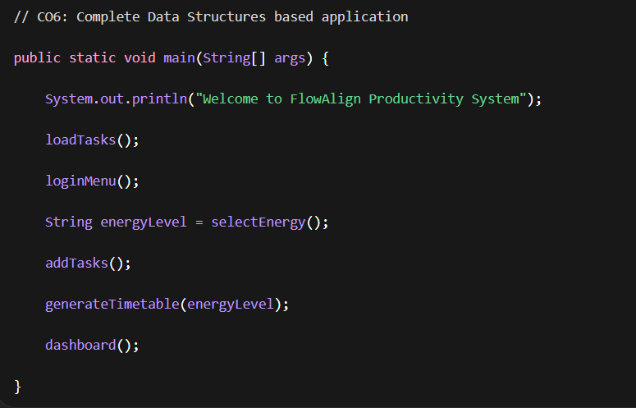
CO5 – Real Application
CO6 – Full Program

Slide 15
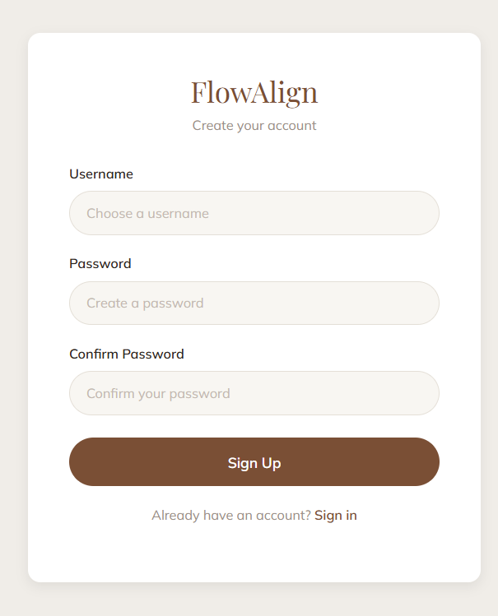
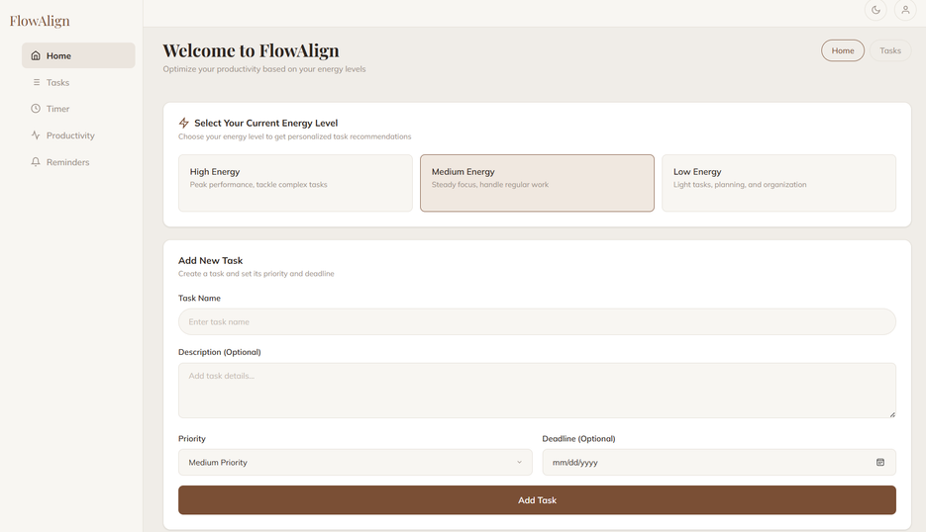
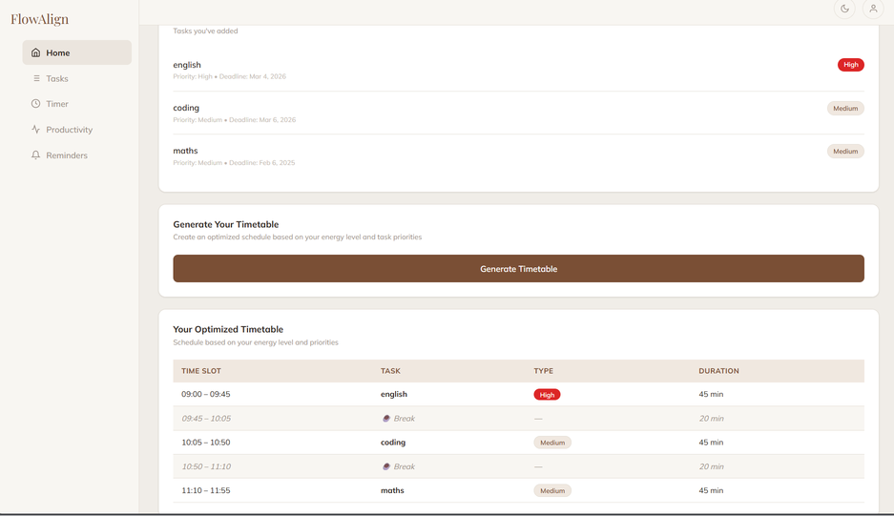
WEBSITE

Slide 16
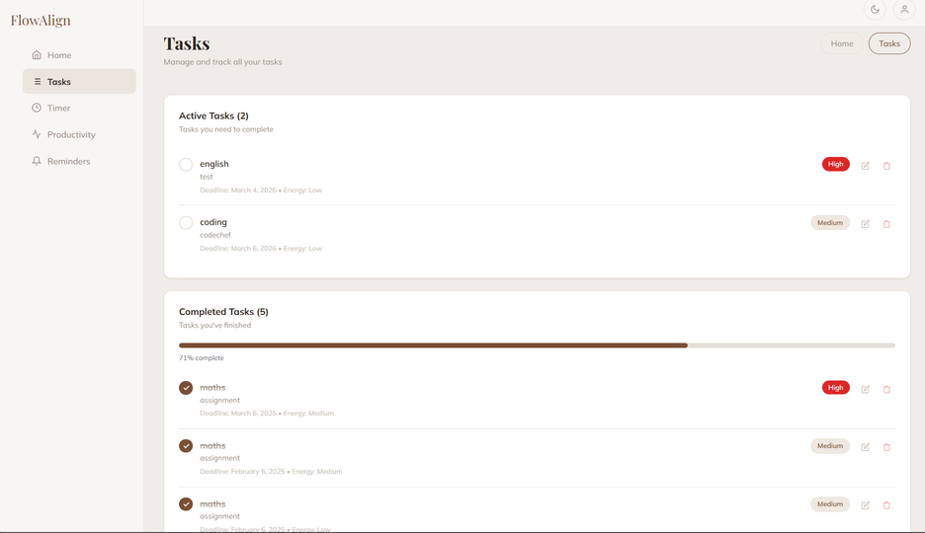
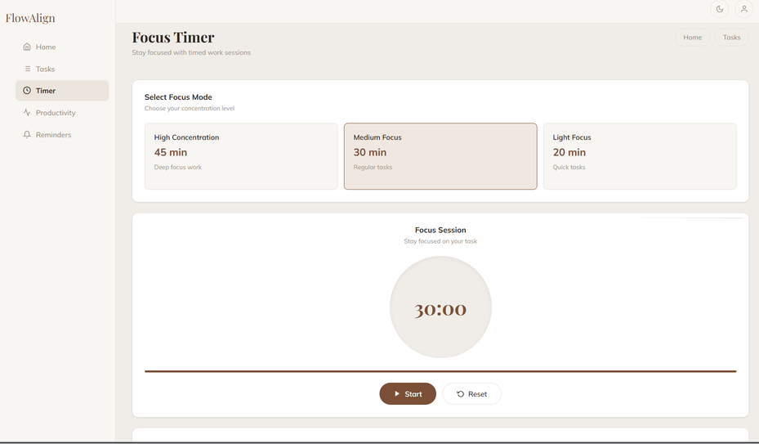
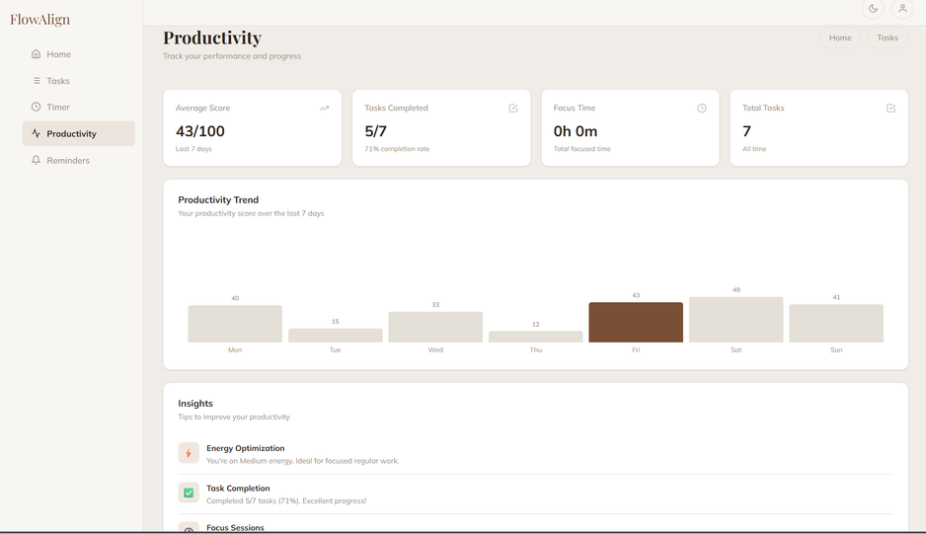
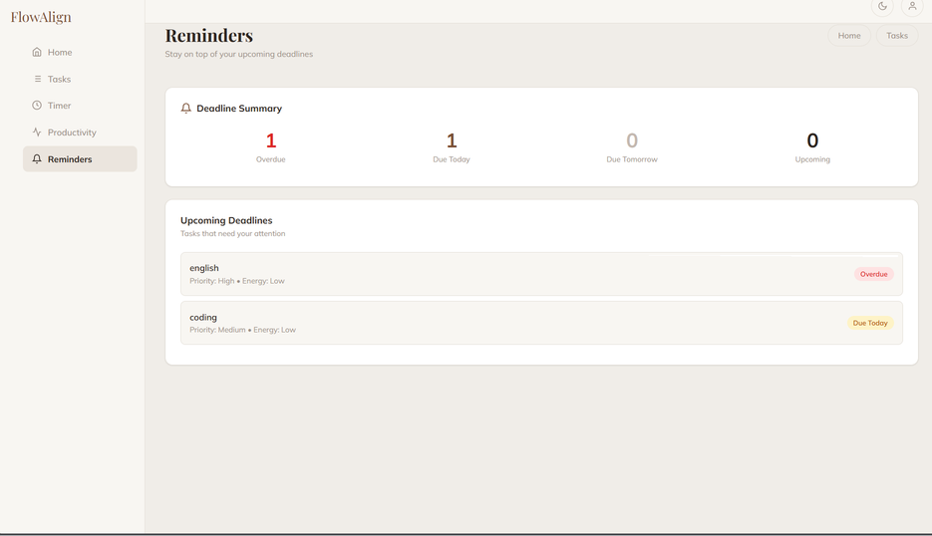
WEBSITE

Slide 17
CONCLUSION
The Energy Driven Personal Productivity Companion introduces a new approach to productivity management by considering the user's energy levels.
It helps users schedule tasks in a way that aligns with their natural productivity cycles.
By assigning tasks based on energy levels, the system ensures that users perform complex tasks when they are most capable.
This improves task completion rate, focus, and overall efficiency.
The project successfully integrates concepts from Frontend Web Development and Data Structures.
It demonstrates how technology can assist individuals in managing their time and work more effectively.
Future improvements may include AI-based productivity analysis, personalized recommendations, and mobile application support.

Slide 18
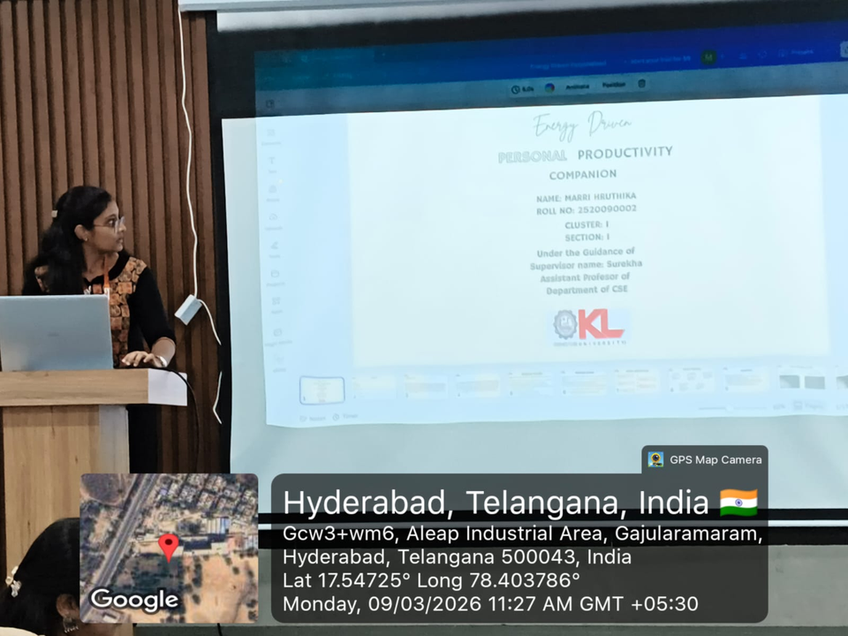
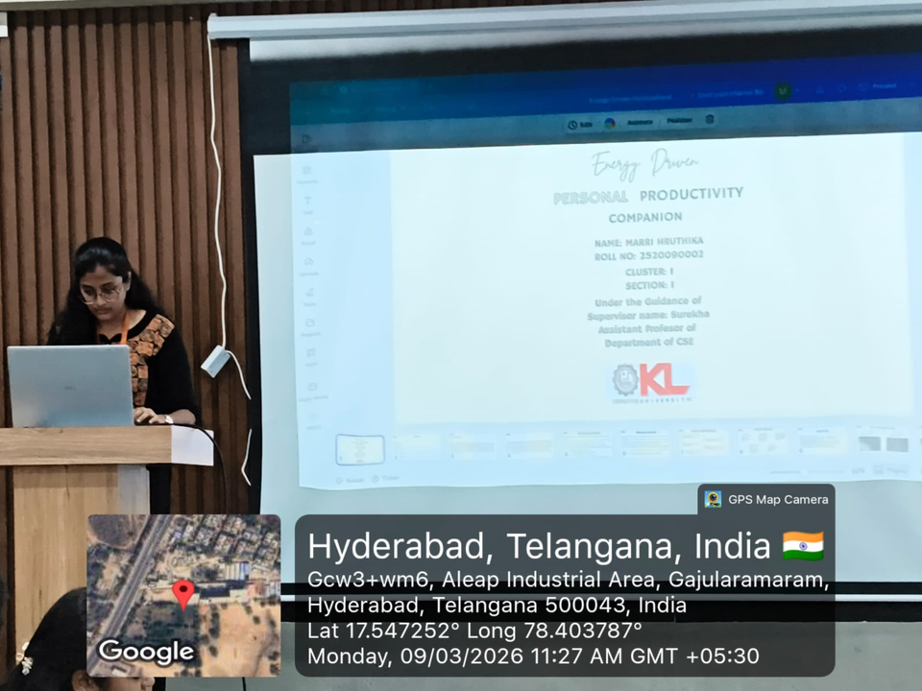
GEO-TAG PHOTOS

Slide 19
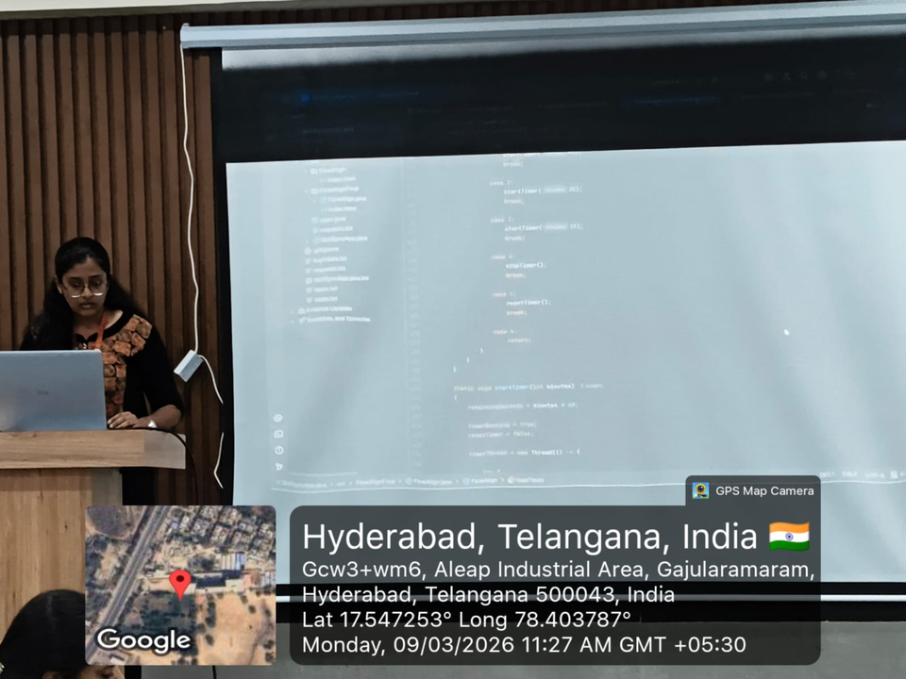
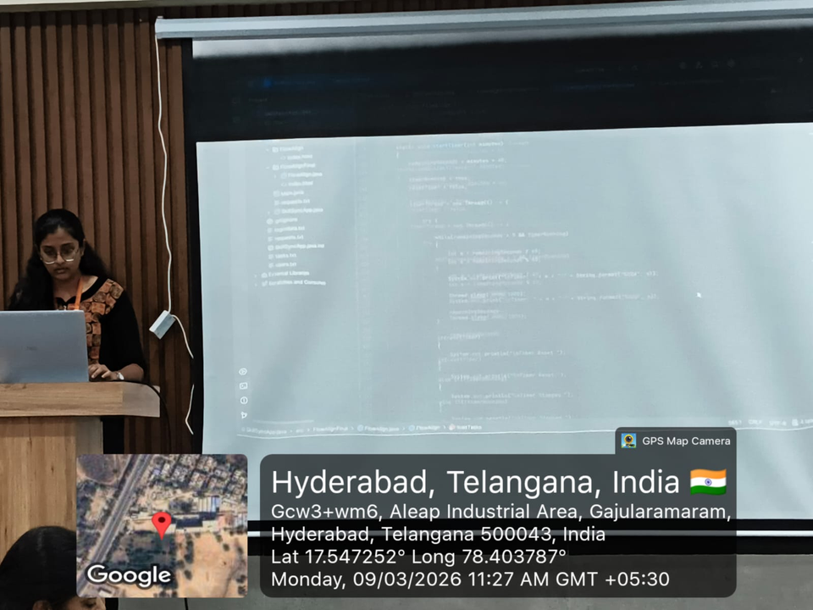
GEO-TAG PHOTOS

Slide 20
THANK YOU

